Slide 1


Slide 2
TEAM MEMBERS:
URVI KASBE
PRITI GAWADE
SNEHA KAMBLE
PAYAL MAURYA
RIYA RANE
UTKARSHA SAMDURE

Slide 3
INTRODUCTION
What is SQL?
SQL, or Structured Query Language, is the standard programming language designed for managing and manipulating relational databases.
Purpose of SQL:
Its core purpose is to facilitate the storage, retrieval, and manipulation of data within databases.
It also provides essential mechanisms for ensuring data integrity and security.
Role in Database Management:
SQL is indispensable for performing fundamental database operations such as querying, updating, inserting, and deleting data.

Slide 4
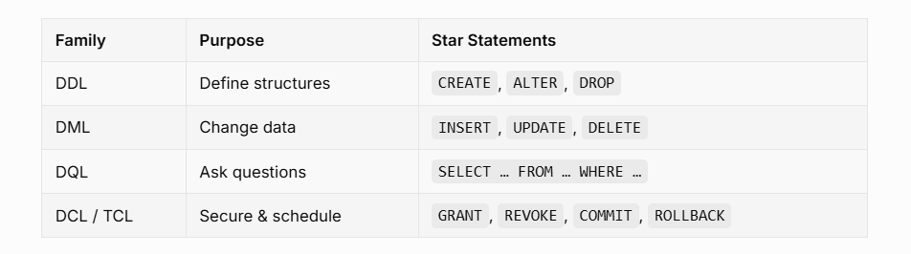
INSIGHTS of SQL
Key Features:

Slide 5
Benefits of Using SQL
Efficiency in Data Management
Streamlines querying and updating; enables automation of repetitive tasks.
Enhanced Data Integrity
Ensures accuracy and consistency through relationships and constraints.
Scalability
Handles large datasets and multiple users simultaneously.

Slide 6
ABSTRACT
Structured Query Language (SQL) plays a critical role in managing hospital databases by providing an efficient and systematic way to store, retrieve, and manipulate healthcare-related data. In a hospital setting, maintaining patient records, doctor schedules, appointments, medical histories, and billing details is crucial for operational efficiency. SQL enables data integrity, security, and quick access to information through its powerful querying capabilities. It helps generate reports that aid in decision-making, such as identifying high-risk patients, tracking revenue, and managing resource allocation. By leveraging SQL, hospitals can ensure smooth workflow automation, minimize errors, and enhance patient care through real-time data management.

Slide 7
OBJECTIVE
To design and implement a Hospital Database Management System using MySQL that ensures efficient storage, management, and retrieval of hospital-related data.
The system aims to:
Develop a well-structured relational database for hospital operations.
Maintain organized records of patients, doctors, staff, appointments, treatments, and billing.
Enable fast and accurate querying to generate reports and support decision-making.
Improve the overall efficiency, reliability, and accessibility of hospital information management.

Slide 8
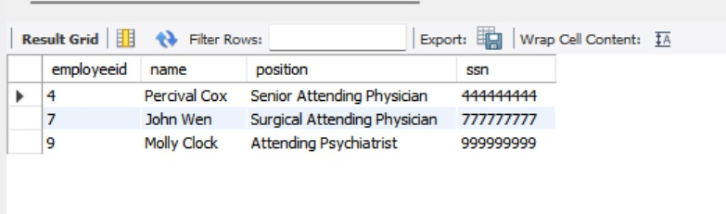
SQL QUERIES:
1. Write a SQL query to identify the physicians who are the department heads.
->select p.employeeid, p.name, p.position, p.ssn from physician p
JOIN department d
On p.employeeid=d.head;
OUTPUT:

Slide 9

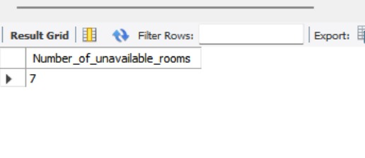
2. Write a SQL query to locate the floor and block where room number 212 is located.
-> select blockfloor, blockcode from room
where room number=212;
OUTPUT:
3. Write a SQL query to count the number of unavailable rooms. Return count as "Number of unavailable rooms".
-> select count(*) as Number_of_unavailable_rooms from room where unavailable='t';
OUTPUT:

Slide 10
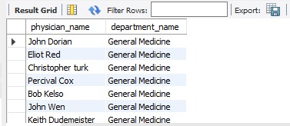
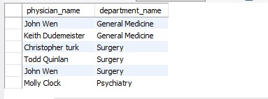
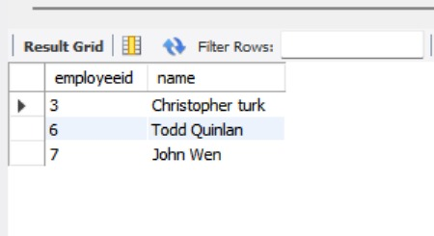
4. Write a SQL query to identify the physician and the department with which he or she is affiliated.
-> SELECT p.name AS physician_name, d.name AS department_name from physician p
JOIN affiliated_with a ON p.employeeid = a.physician
JOIN department d ON a.department = d.departmentid;
OUTPUT:
5. Write a SQL query to find those physicians who have received special training.
-> select DISTINCT p.employeeid, p.name from physician p
JOIN trained_in t
ON p.employeeid=t.physician;
OUTPUT:

Slide 11

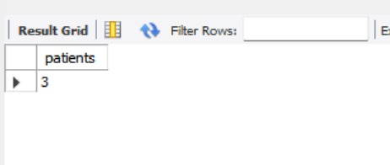
6. Write a SQL query to identify the patients and the number of physicians with whom they have scheduled appointments.
->SELECT p.ssn, p.name, count(DISTINCT a.physician) AS num_physicians
FROM patient p
JOIN appointment a ON p.ssn = a.patient
GROUP BY p.ssn, p.name;
OUTPUT:
7.Write a SQL query to count the number of unique patients who have been scheduled for examination room 'C'.
->select count(DISTINCT patient) as patients from appointment where examination room='C';
OUTPUT:

Slide 12
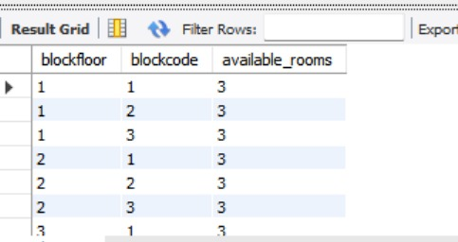
8.Write a SQL query to count the number of available rooms for each floor in each block. Sort the result-set on floor ID, ID of the block.
-> SELECT
blockfloor,
blockcode,
COUNT(*) AS available_rooms
FROM Room
WHERE unavailable = 'f' OR unavailable = 0
GROUP BY blockfloor, blockcode
ORDER BY blockfloor, blockcode;
OUTPUT:

Slide 13
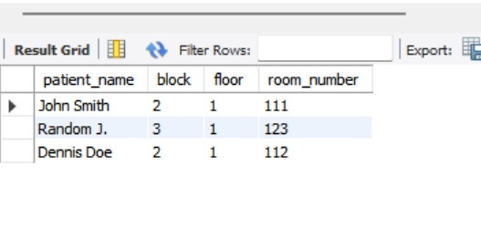
9. Create a view to display the name of the patients, their block, floor, and room number where they are admitted.
->p.name AS patient_name,
r.blockcode AS block,
r.blockfloor AS floor,
r.roomnumber AS room_number
FROM Patient p
JOIN Stay s
ON p.ssn = s.patient
JOIN Room r
ON s.room = r.roomnumber;
SELECT * FROM PatientRoomDetails;
OUTPUT:

Slide 14
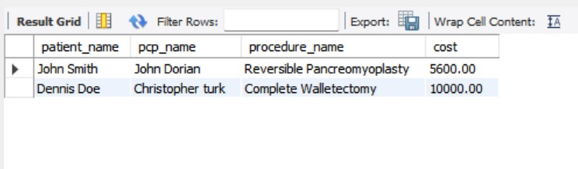
10.Write a SQL query to find those patients who have undergone a procedure costing more than $5,000, as well as the name of the physician who has provided primary care, should be identified.
>pat.name AS patient_name,
phy.name AS pcp_name,
pr.name AS procedure_name,
pr.cost
FROM Patient pat
JOIN Undergoes u
ON pat.ssn = u.patient
JOIN Procedures pr
ON u.procedures = pr.code
JOIN Physician phy
ON pat.pcp = phy.employeeid
WHERE pr.cost > 5000;
OUTPUT:

Slide 15
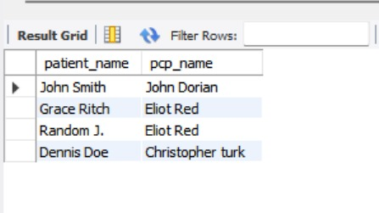
11.Write a SQL query to identify those patients whose primary care is provided by a physician who is not the head of any department.
-> p.name AS patient_name,
phy.name AS pcp_name
FROM Patient p
JOIN Physician phy
ON p.pcp = phy.employeeid
WHERE p.pcp NOT IN (
SELECT head
FROM Department
WHERE head IS NOT NULL
);
OUTPUT:

Slide 16

12. Retrieve the names of patients who have been prescribed at least one medication by a physician from the Psychiatry department using a subquery.
->SELECT DISTINCT p.name
FROM patient p
WHERE p.ssn IN (
SELECT pr.patient
FROM prescribes pr
WHERE pr.physician IN (
SELECT physician
FROM affiliated_with
WHERE department = (
SELECT department_id
FROM department
WHERE name = 'Psychiatry') ) );
OUTPUT:

Slide 17
13.Create a trigger that prevents inserting a new appointment if the physician does not have a primary affiliation with a department.
->
DELIMITER $$
CREATE TRIGGER check_physician_primary_affiliation
BEFORE INSERT ON appointment
FOR EACH ROW
BEGIN
-- Count primary affiliations
IF (SELECT COUNT(*)
FROM affiliated_with
WHERE physician = NEW.physician
AND primaryaffiliation = 't') = 0 THEN
SIGNAL SQLSTATE '45000'
SET MESSAGE_TEXT = 'Error: Physician does not have a primary department affiliation.';
END IF;
END $$
DELIMITER ;
OUTPUT: “SUCCESSFUL”
IF WANT TO CHECK THE TRIGGER IS WORKING :
INSERT INTO appointment (appointmentid, patient, prepnurse, physician, startdatetime, enddatetime, examinationroom)
VALUES (999999, 100000001, 101, 10, '2008-04-28 10:00:00', '2008-04-28 11:00:00', 'A');
IF IT SHOWS ERROR THEN IT MEANS THE TRIGGER IS WORKING.

Slide 18
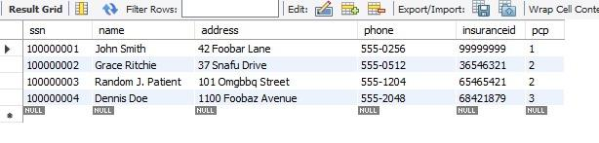
14. Update the insurance ID of patients whose primary care physician (PCP) is 'John Dorian' to a new value '99999999'.
->UPDATE patient
SET insuranceid = 99999999
WHERE pcp = (
SELECT employeeid
FROM physician
WHERE name = 'John Dorian'
);
OUTPUT:

Slide 19
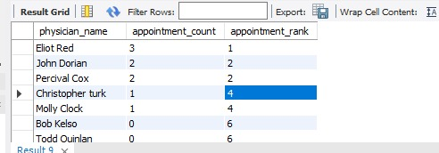
15. Retrieve each physician's name along with the number of appointments they have, and show the ranking of each physician based on the number of appointments in descending order.
=>SELECT
ph.name AS physician_name,
COUNT(a.appointmentid) AS appointment_count,
RANK() OVER (ORDER BY COUNT(a.appointmentid) DESC) AS appointment_rank
FROM physician ph
LEFT JOIN appointment a
ON ph.employeeid = a.physician
GROUP BY ph.employeeid, ph.name
ORDER BY appointment_count DESC;
OUTPUT:

Slide 20
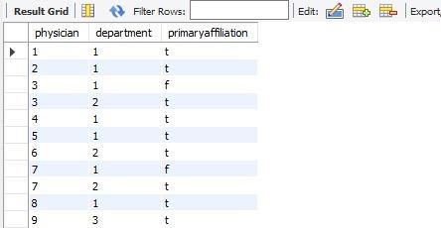
affiliated_with Table:

Slide 21
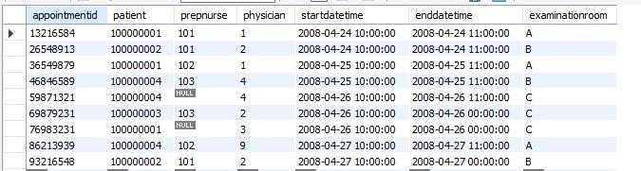
Appointment table:

Slide 22
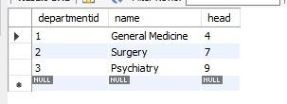
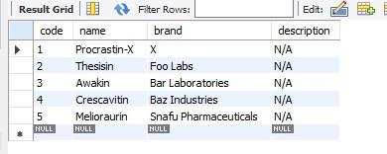
Department Table:
Medication Table:

Slide 23
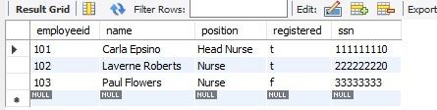
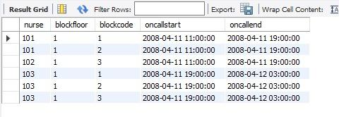
Nurse table:
On_call table:

Slide 24
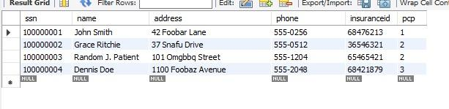
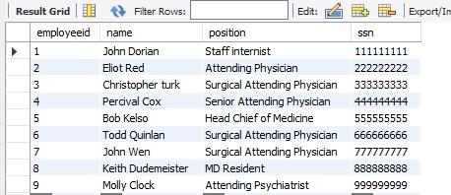
Patient table:
Physician Table:

Slide 25
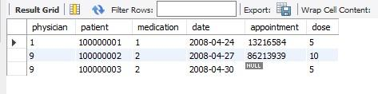
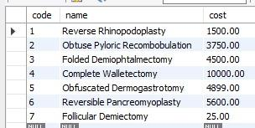
Prescribes Table:
Procedure Table:

Slide 26
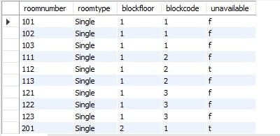
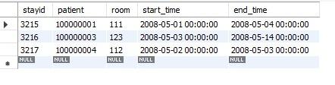
Room Table:
Stay Table:

Slide 27

Trained_in Table:

Slide 28
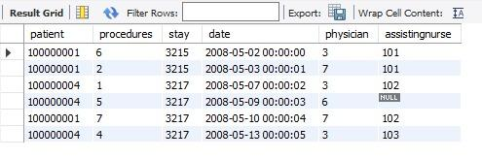
Undergoes Table:

Slide 29
REPORT OF THE ASSIGNMENT:
The Hospital Management System using SQL effectively demonstrates how relational databases help streamline and optimize healthcare operations.
SQL enables efficient management of hospital data such as patient records, staff information, appointments, room allocations, and medical procedures.
Advanced SQL features like views, triggers, window functions, and subqueries significantly improve data integrity, automation, and system reliability.
The system supports faster and more accurate decision-making through powerful data retrieval and reporting capabilities.
SQL-based automation reduces manual errors and enhances overall operational efficiency within hospital workflows.
This project emphasizes the essential role of database management in modern healthcare environments.
The work provides a strong foundation for creating a fully functional and scalable Hospital Management System application in the future.

